Slide 1
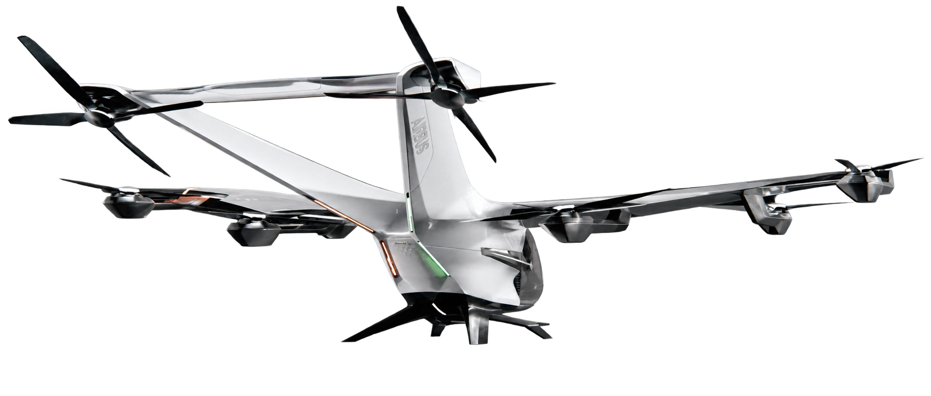
Mapping Propeller Noise
Across Scales
Can subscale tests reveal noise patterns at larger scales?
Boyang (Jerry) Chen
Aircraft Systems Laboratory
UC Irvine
Faculty mentor: Jacqueline Huynh
Aircraft: Airbus, CityAirbus NextGen.
01
Notes:
My project asks whether small propeller experiments can tell us something useful about a much larger aircraft. I'll start with why this matters, then show the test platform, the simulation approach, and the patterns we've seen so far.

Slide 2
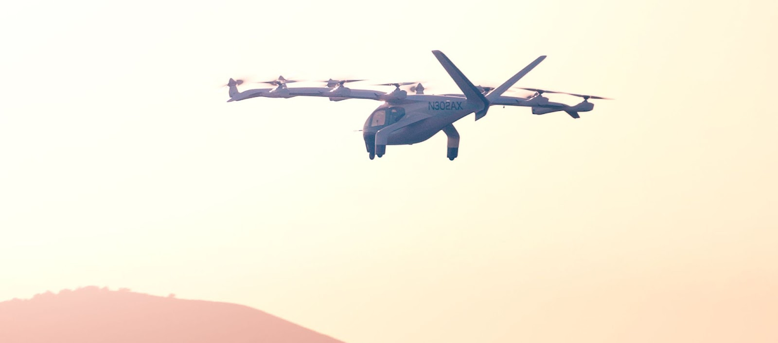
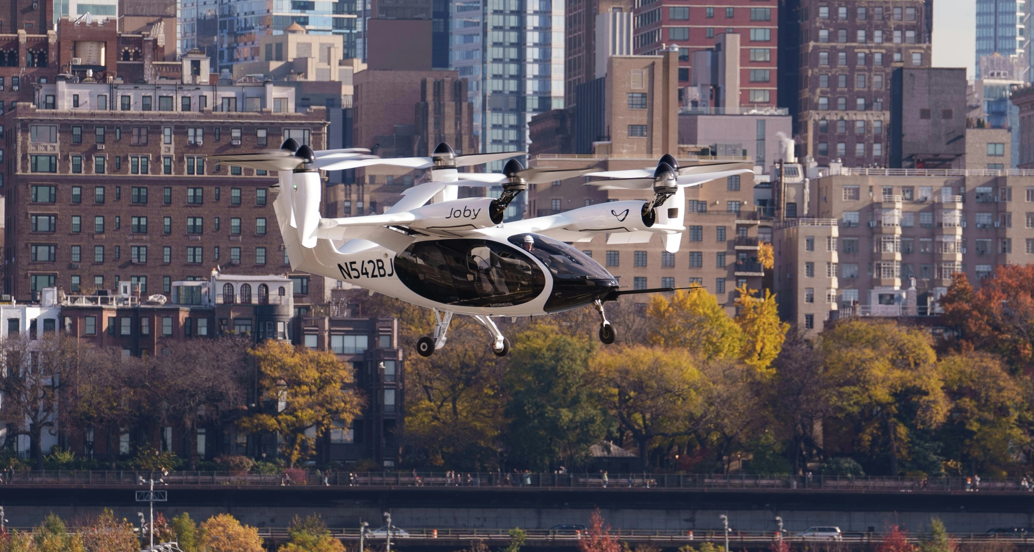
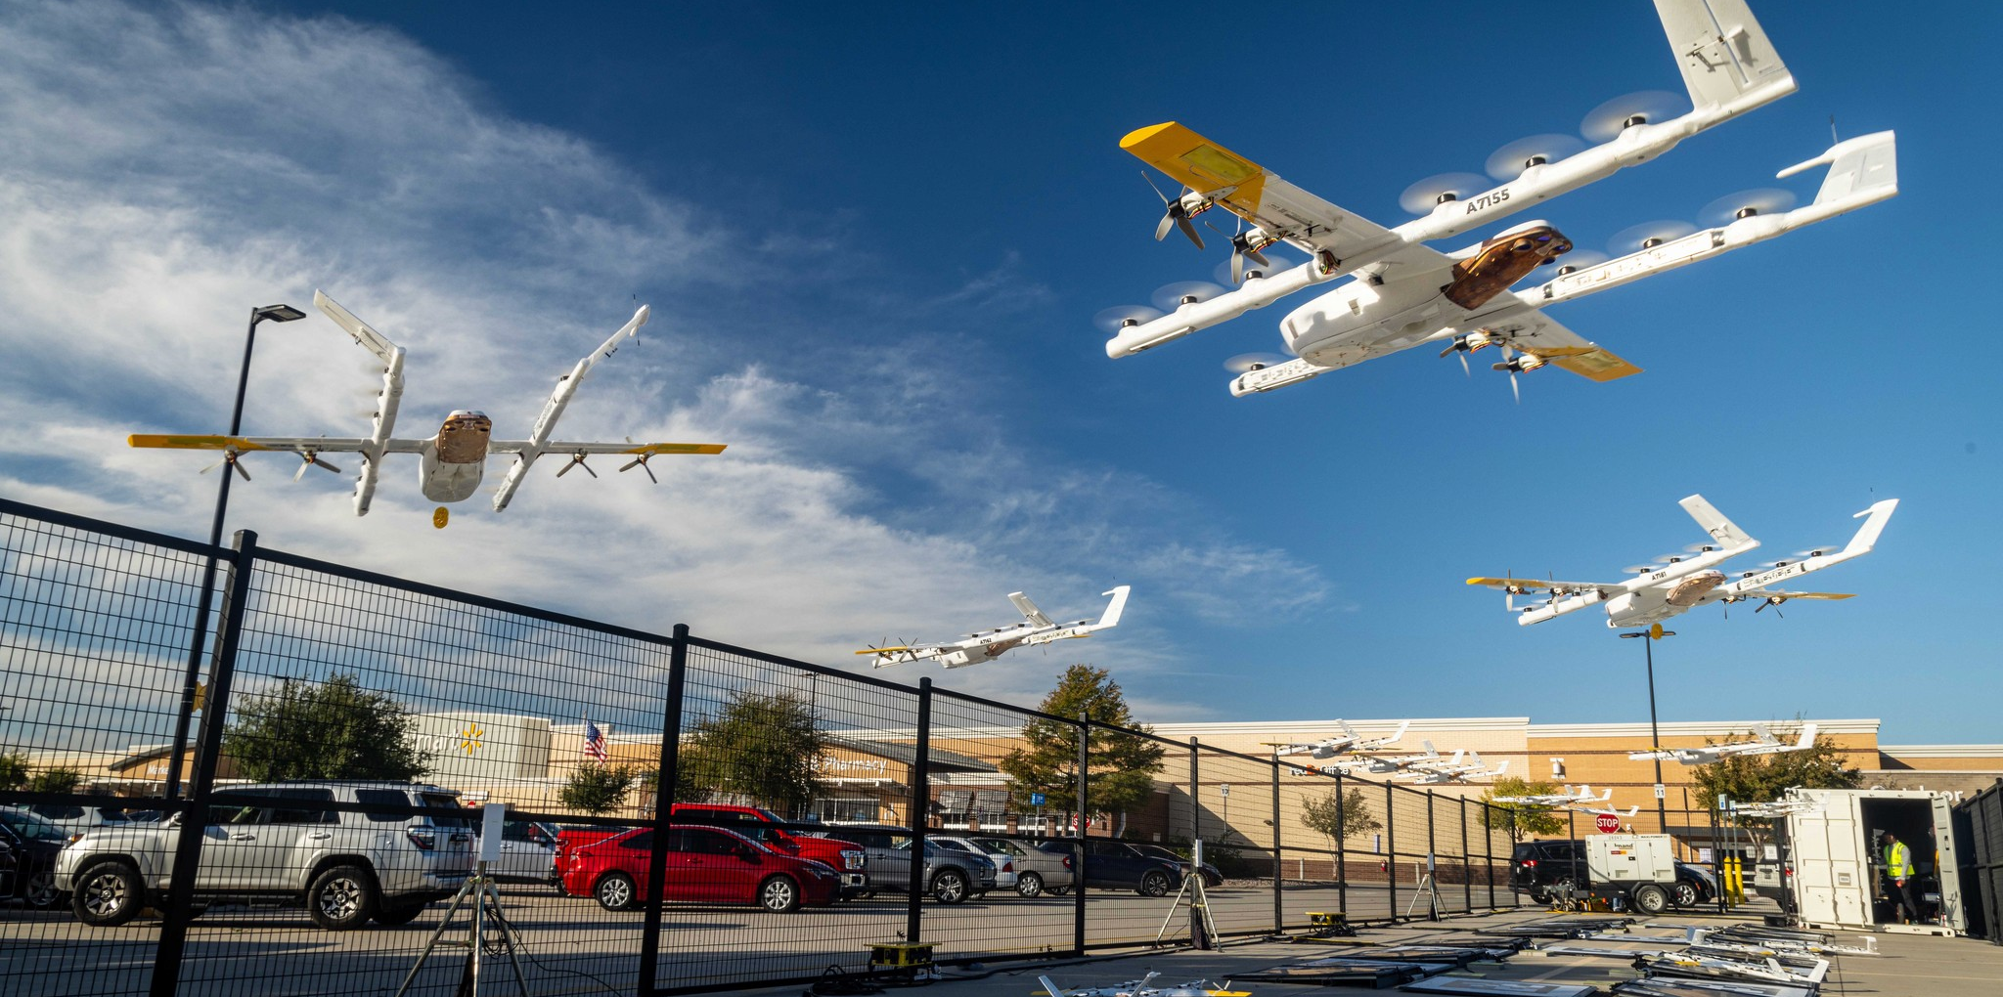
New aircraft layouts, enabled by electrification proposed for air transportation
New ways to move people and goods through cities
Archer Midnight
Joby aircraft over New York City
Aircraft design must balance transport efficiency
with noise around communities.
Drone delivery at Walmart
Photos: Joby Aviation (2023), Archer Aviation / Business Wire (2024). Photo montage: Wing (2025).
02
Notes:
As low altitude aviation grows and control technology improves, designers have more freedom to try unconventional layouts. Multiple electric motors let them rethink where the propellers go to improve performance and efficiency. We already see drone deliveries in residential areas, while passenger aircraft are being tested over cities. For transportation, the goal is to move people and goods efficiently while managing the noise around communities.

Slide 3
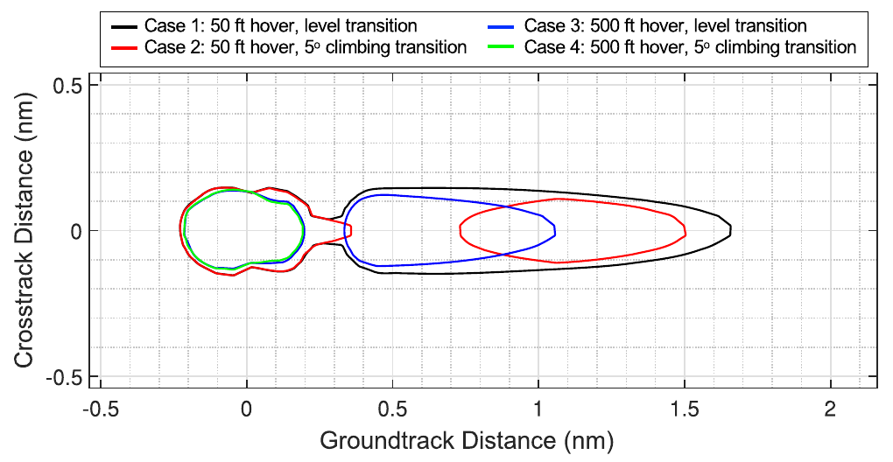
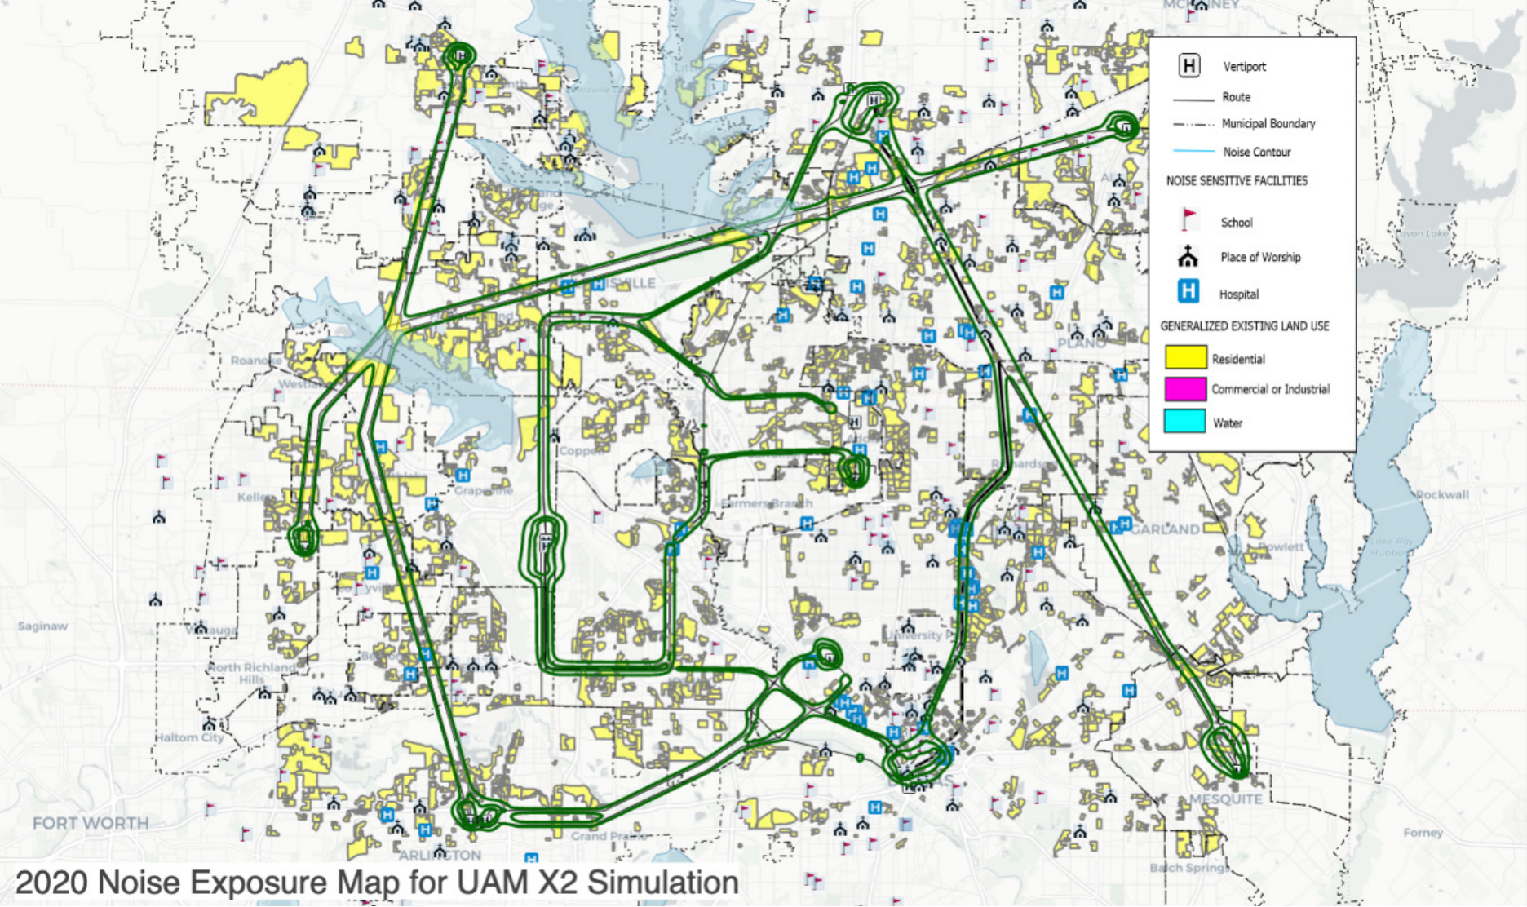
Aircraft layout also changes the noise footprint
Noise footprints matter when planning air transport near communities.
Different takeoff procedures, different footprints
Urban air mobility scenario
Predicted 65 dB(A) event maximum contours
NASA simulation over the Dallas area
Motivation
Predict full scale performance and noise from sub scale tests
Reduce the need for large wind tunnel campaigns
Reduce costly simulations during early aircraft design
Left: Gonzalez et al. (2025), Fig. 14, doi.org/10.2514/1.C038248. Right: Li et al., NASA (2021). Different cases and metrics.
03
Notes:
Aircraft layout and the way we fly both affect where noise reaches the ground. The figure on the left comes from our paper. It shows the same aircraft using four takeoff procedures, with different predicted noise footprints. The map on the right shows a simulated urban air mobility network over Dallas. The metrics are different, so we shouldn't compare the colors directly. This is why we need an efficient way to explore noise during design. Full scale wind tunnel tests and detailed simulations are expensive. Our goal is to get useful full scale performance and noise predictions from smaller experiments, reducing the number of costly tests and simulations we need.

Slide 4
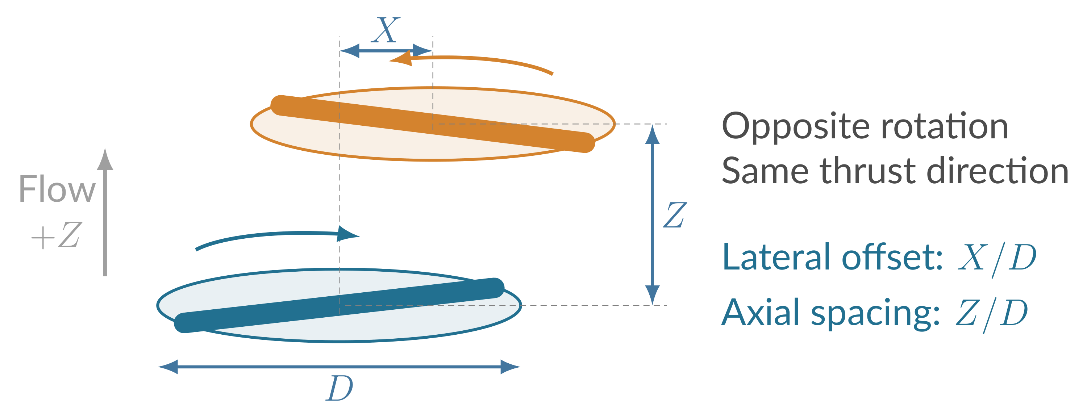
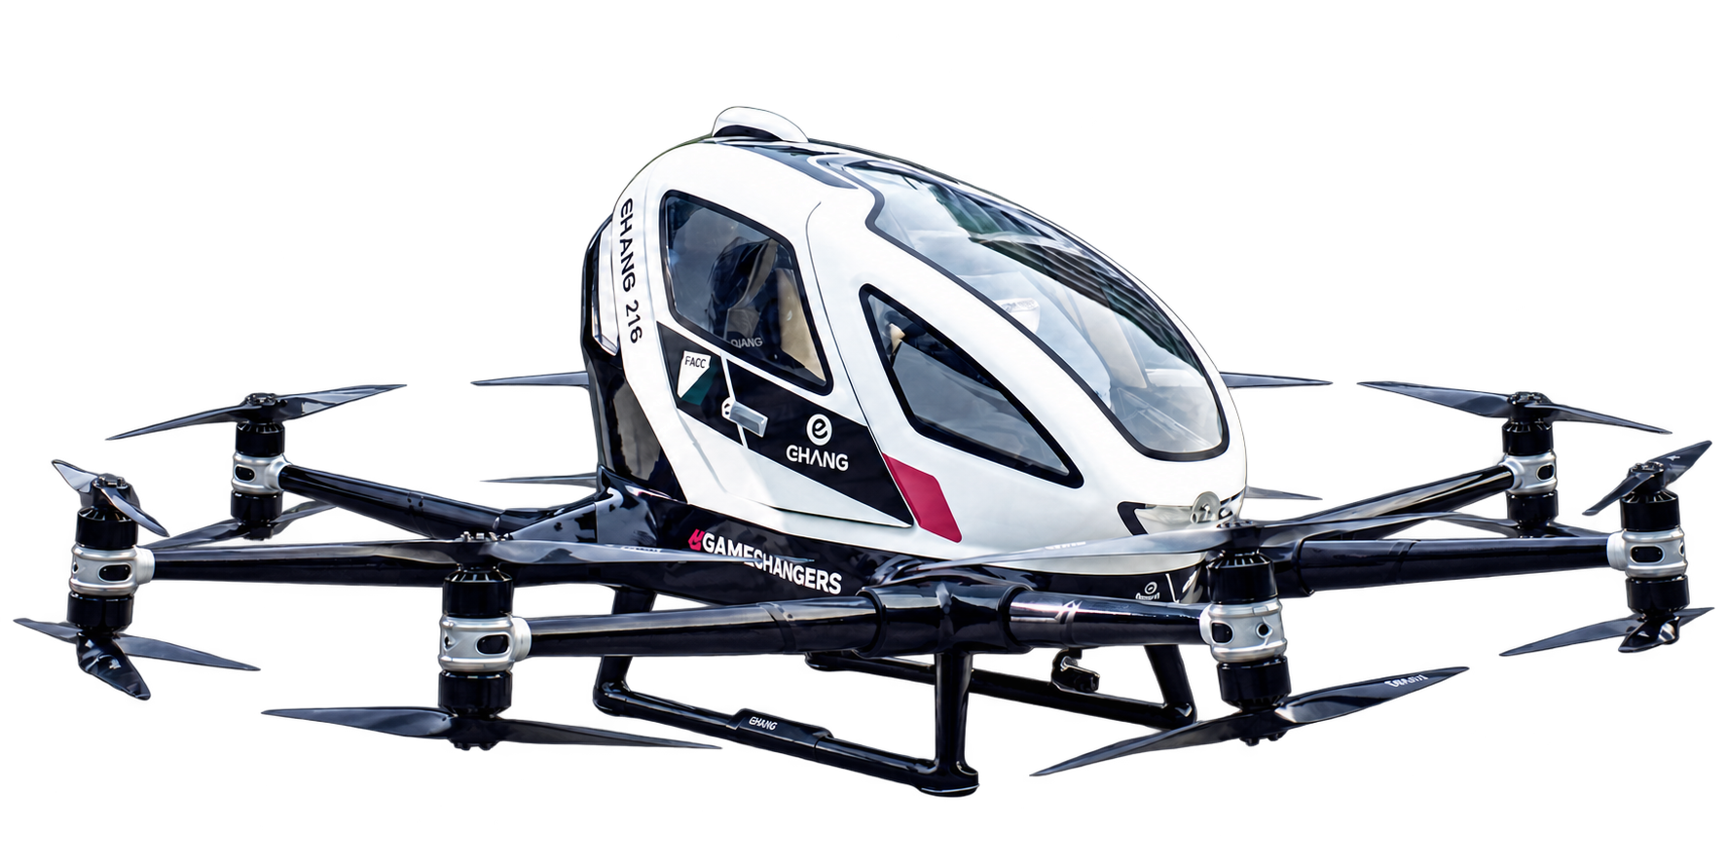
The operational and geometrical variability in UAM viechles
Counter rotating propeller pair
N₂ (rpm)
N₁ (rpm)
EHang 216
Independent inputs
Responses and similarity
Spacing X, Z
Diameter D
Rotor speeds N₁ and N₂
Tip Mach numbers and Reynolds numbers
Thrust T₁, T₂ and torque Q₁, Q₂
Noise level in dB(A)
Aircraft photo: FACC / Maximilian Lottmann. Counter rotating pair highlighted.
04
Notes:
This real aircraft uses pairs of propellers that rotate in opposite directions. The highlighted pair connects to the simple diagram on the right. Let's take just two propellers as an example. We can change their sideways offset, their axial gap, and the speed of each rotor independently. Those choices change both performance and noise. Thrust and torque are responses we want to understand. Tip Mach number and Reynolds number help us compare operating conditions across sizes.

Slide 5
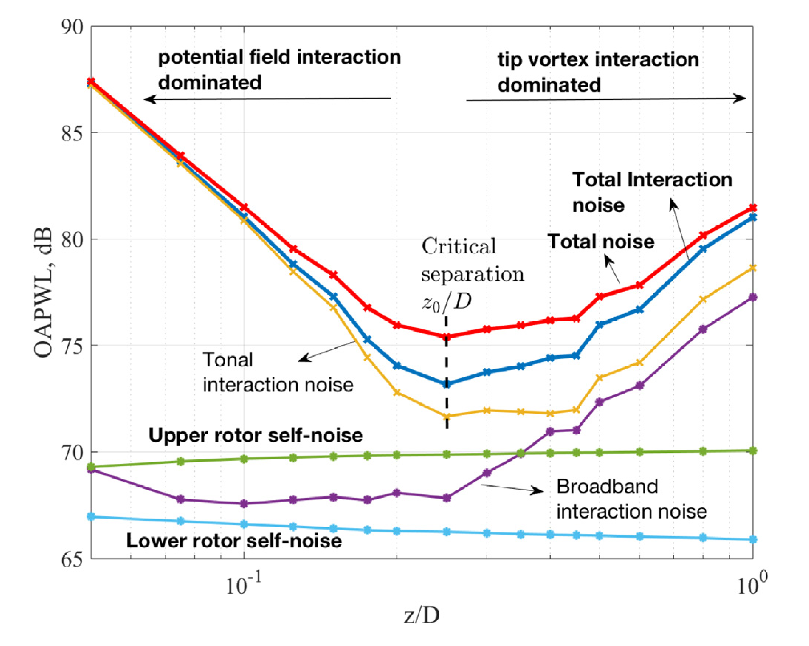
Contributors to rotor noise
1
Blade motion and loading
2
Potential field interaction
3
Viscous wake interaction
4
Tip vortex interaction
5
Turbulence and edge scattering
Geometry and operating conditions changes the balance between these contributions.
Figure: Chaitanya et al. in Schram and Bennett (2024), Fig. 14, CC BY 4.0. Mechanisms: Kingan and Parry (2020).
05
Notes:
With two rotors, the changes in performance and noise become much more complicated than for a single propeller. Several sources interact, and their relative importance changes with spacing and speed. These are the five main contributors. I won't go into each mechanism here. The key point is that changing the gap doesn't always make the system quieter.

Slide 6
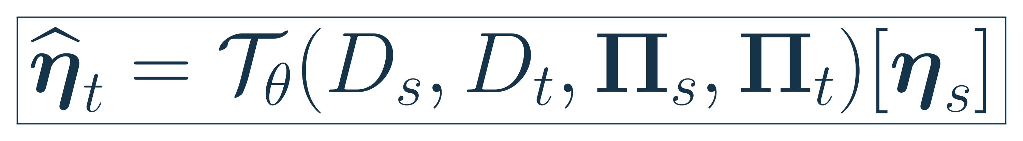
Our hypothesis: mapping across scales
Could sub scale models predict full scale performance and noise?
Approach:
1.Physical experiments
2.Computational simulation
Sub scale measurements
ML or statistical relation
Full scale prediction
Predict full scale
performance and noise
Sub scale model
Full scale model
Noise mapping hypothesis; thrust and torque are parallel targets. Aircraft: Airbus, CityAirbus NextGen.
06
Notes:
That leads to my main question. Could we test a small model with the same geometry, then use a table or a function to predict the performance and noise at full size? If that works, engineers could reduce their reliance on large wind tunnel campaigns and expensive computer simulations during early design. I'm approaching this with physical experiments and simulations. Automated test data and the simulated results feed into a machine learning or statistical relation. The formula represents the noise mapping we want to learn. It remains a hypothesis, and the real test is whether it predicts a size we didn't use to build it.

Slide 7
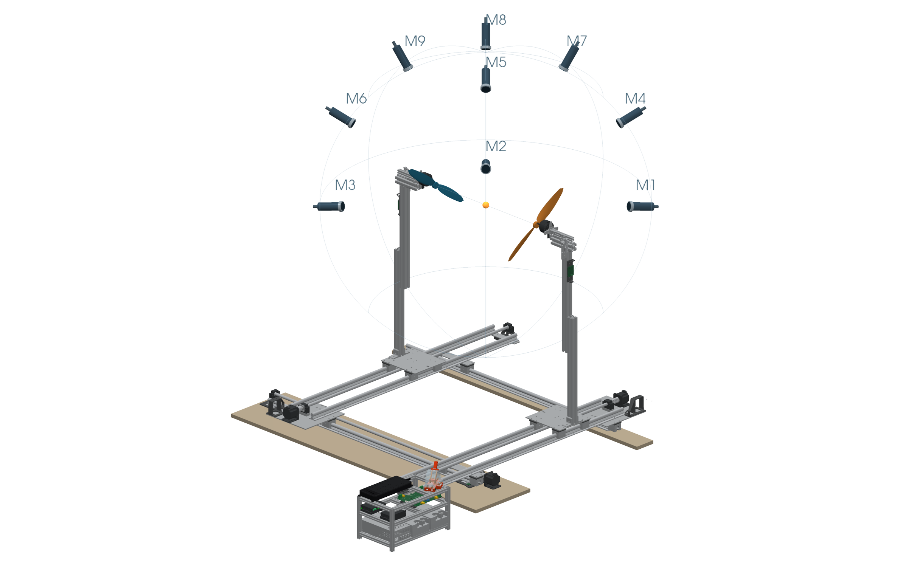
Approach: 1. Physical Experiments
A platform for systematic spacing experiments
Selected propellers
8,12,24 in diameter propeller
of same geometry
Planned sweep
X and Z: 200 to 1500 mm
Each rotor: 0 to 10,000 rpm
Microphone array
Record A weighted
sound pressure levels
Nine microphones sample different directions around the rotor pair.
Collect noise measurements across positions, operating conditions and propeller diameters.
Proposed dual stand configuration with a conceptual hemisphere microphone array.
07
Notes:
I need data from many conditions, so I'm building a platform that can change the geometry systematically. This is the proposed paired setup. We'll test eight, twelve, and twenty four inch propellers with the same geometry. The planned sweep covers X and Z separations from two hundred to fifteen hundred millimetres, with rotor speeds from zero to ten thousand RPM. The nine microphones sit at different angles around the rotor pair and record A weighted sound pressure levels. This lets us collect noise measurements across positions, operating conditions, and propeller diameters.

Slide 8
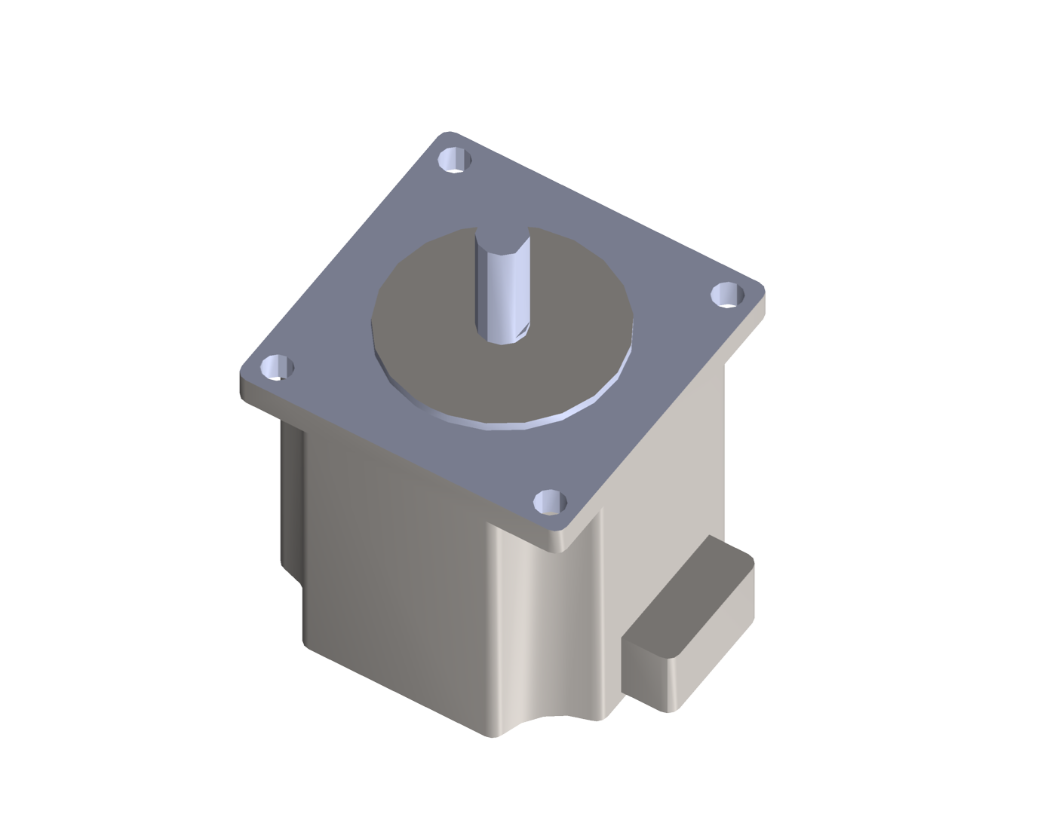
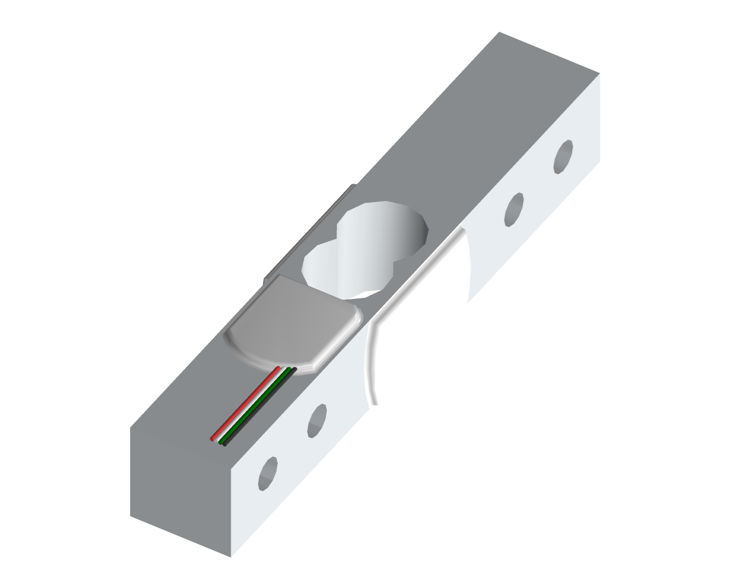
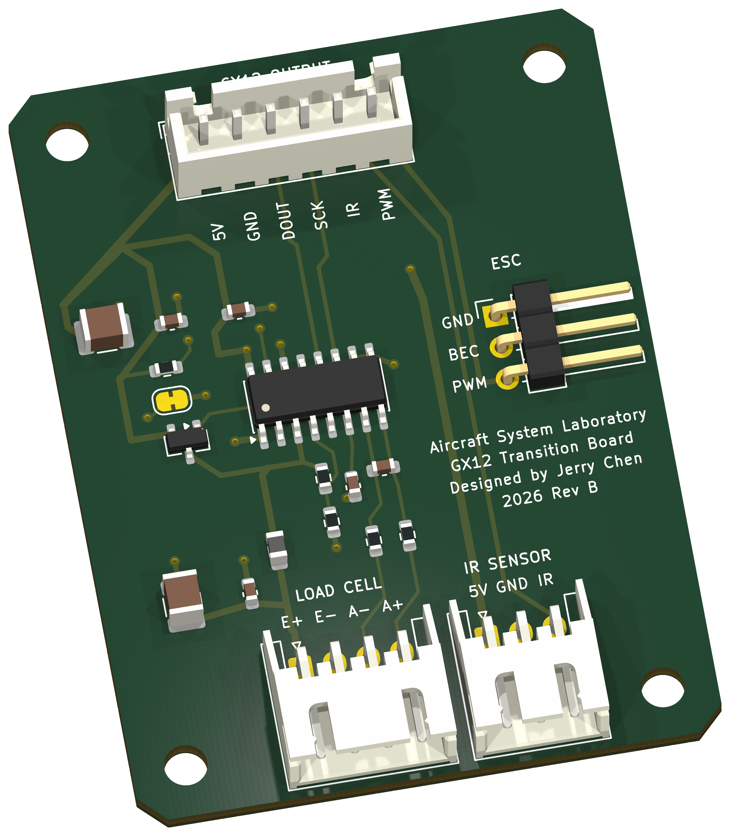
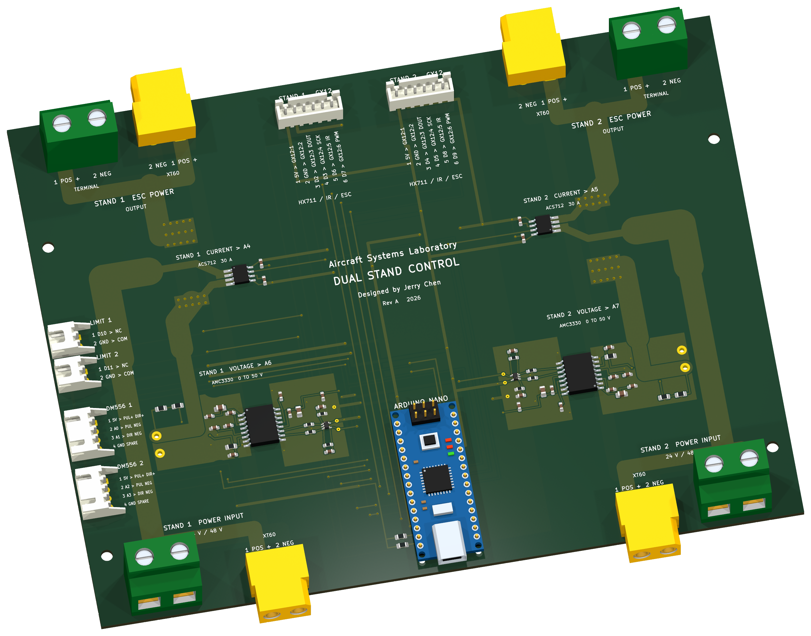
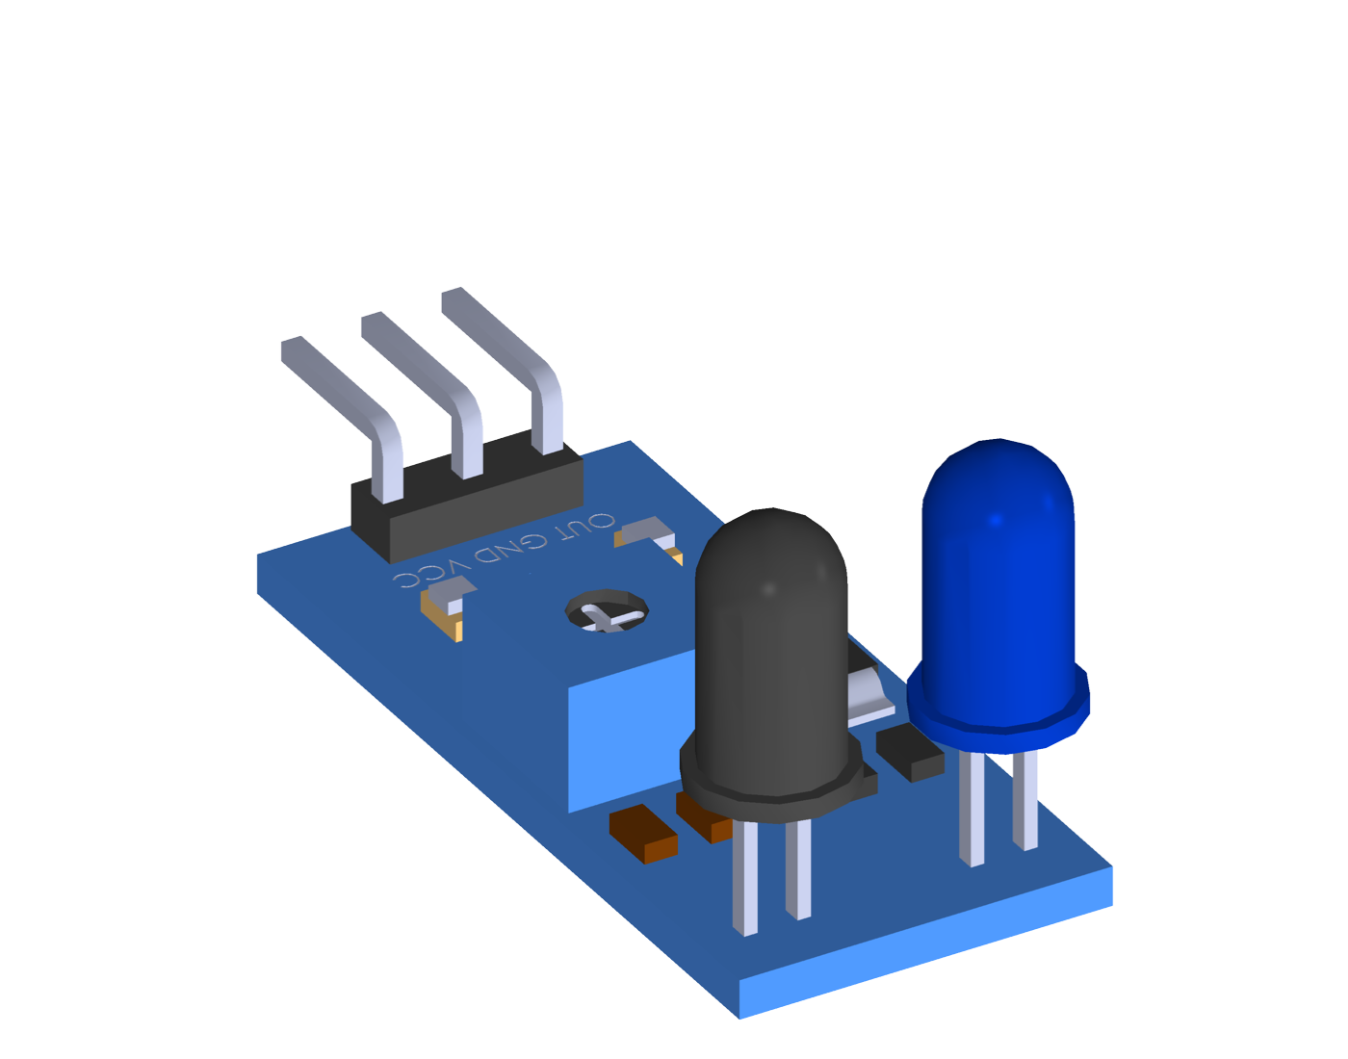
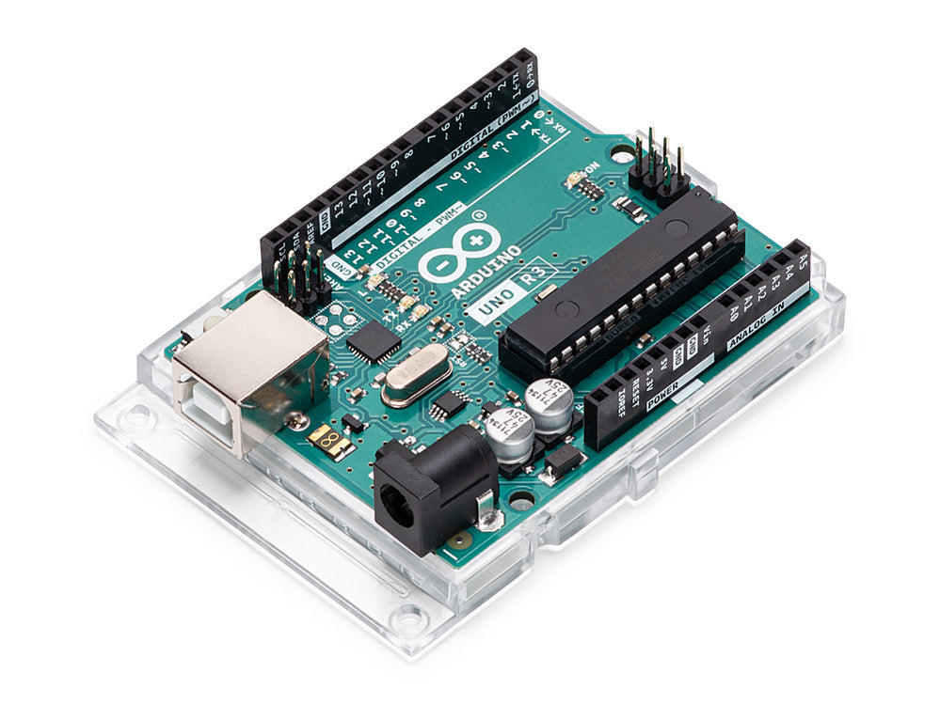
Experiment Test Stand Hardware
Stepper motor
Load cell
Precisely controls
propeller position
Measures propeller thrust
Control carrier PCB
Test head PCB
IR sensor
Arduino controller
Routes power and
control signals
Connects force and
RPM sensors
Measures rotor speed
for feedback control
Runs motion and
rotor speed control
Two custom boards consolidate the wiring
PC targets
rₖ
Speed error
eₖ = rₖ − Nₖ
Coarse P / fine PI
Correction Δuₖ
Update ESC pulse
uₖ = uₖ₋₁ + Δuₖ
ESC + motor
Independent loop for each rotor
Count based RPM estimate
Optical blade detection
Component views from project CAD and PCB designs. Arduino photo: Arduino, UNO Rev3 representative controller.
08
Notes:
This is the hardware I used. The stepper motors let us set the propeller positions precisely. The load cells measure thrust, and the IR sensors measure rotor speed so the controller can keep it on target. The Arduino runs the motion and speed control. The large PCB routes power and control signals, while the smaller board connects the force and RPM sensors at each test head. Together, they turn the wiring into two organized boards.

Slide 9
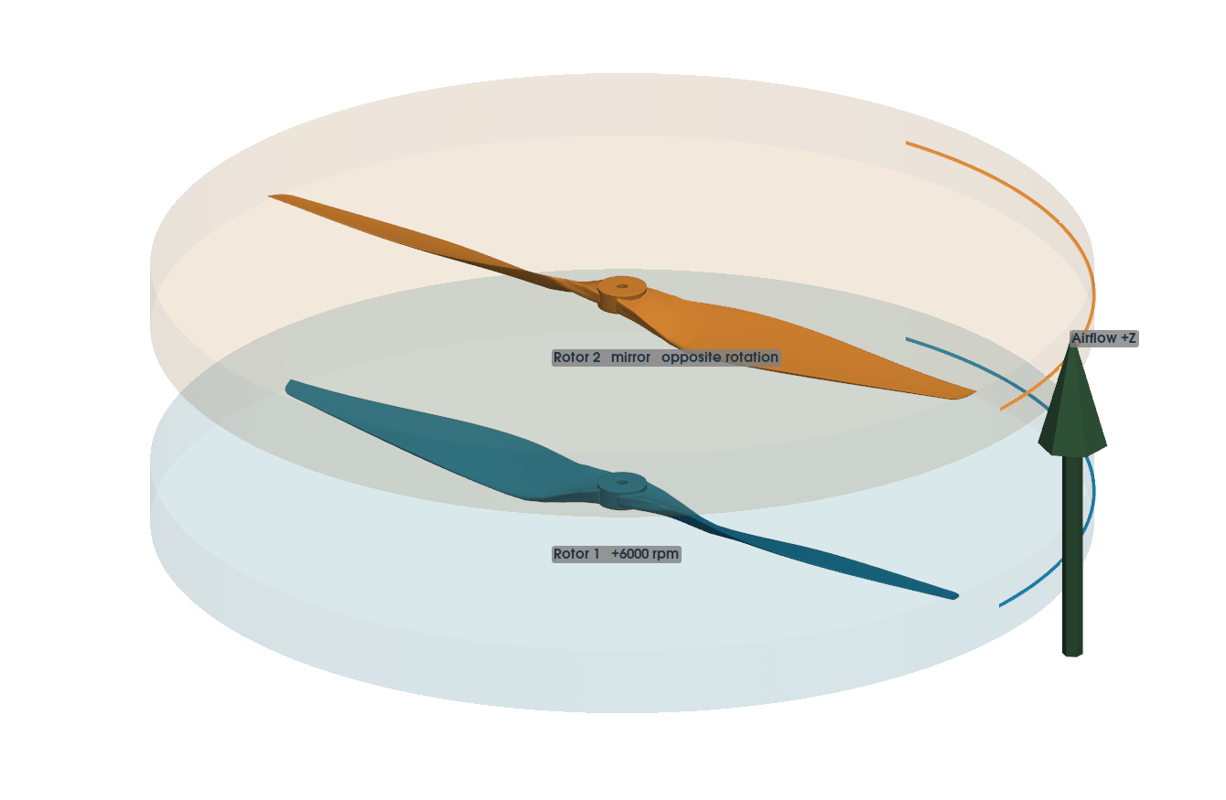
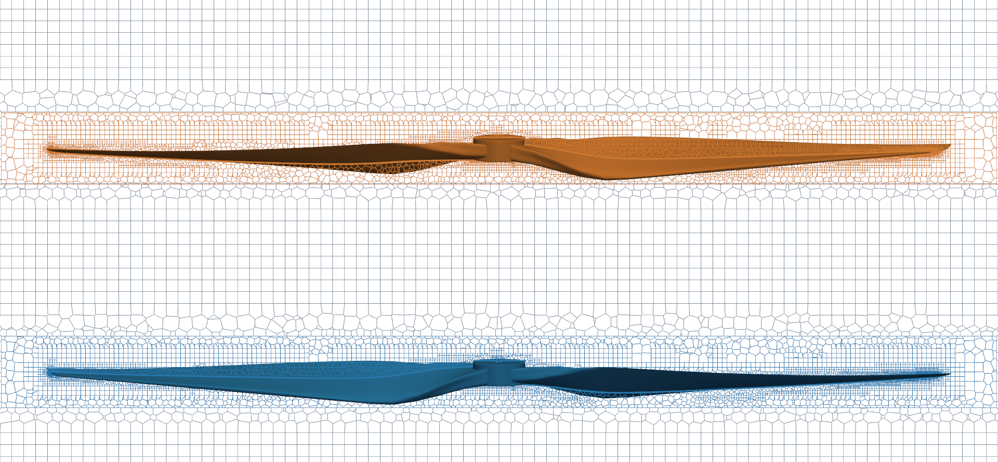
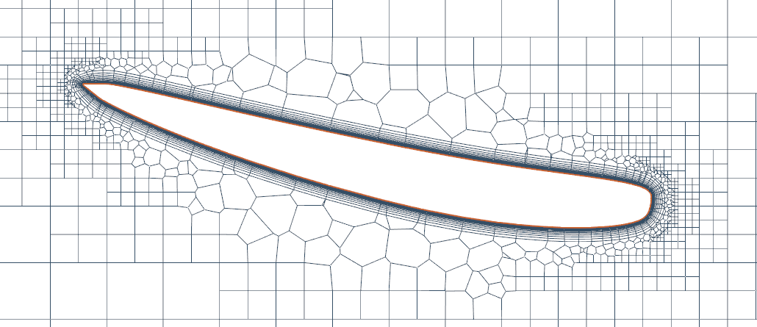
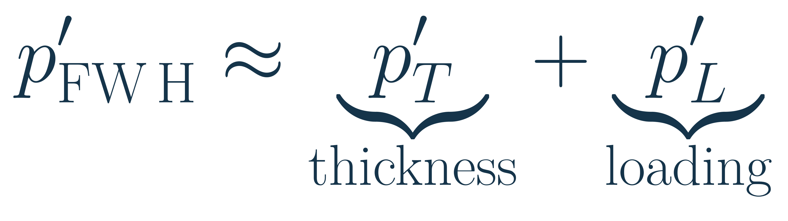
Approach: 2. Simulating the airflow and sound
For cases where there is an incoming airflow, data will be gathered from simulation
APC 24 × 12E simulation setup
Opposite rotation at 6000 rpm. Z/D = 0.25.
Finer mesh near the blades
and between the rotors.
CFD and acoustic setup in progress. FW H method: Ffowcs Williams and Hawkings (1969), doi.org/10.1098/rsta.1969.0031.
09
Notes:
At the same time, we're modelling the same propellers on the computer. This is especially useful when we want to include incoming airflow. We simulate how air moves around the blades, then use the changing pressure and blade loads to predict the sound farther away. We use a finer mesh close to the blades and between the rotors, where the flow changes most. Comparing the simulations with physical measurements will help us check the numerical method as well as study the propeller noise.

Slide 10
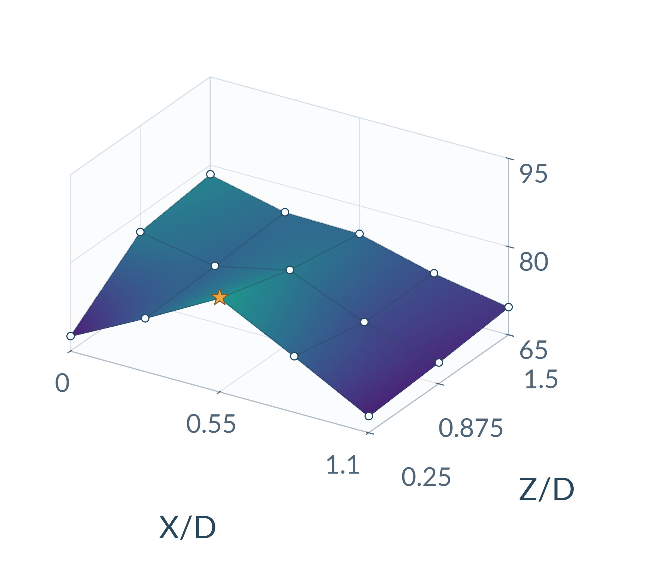
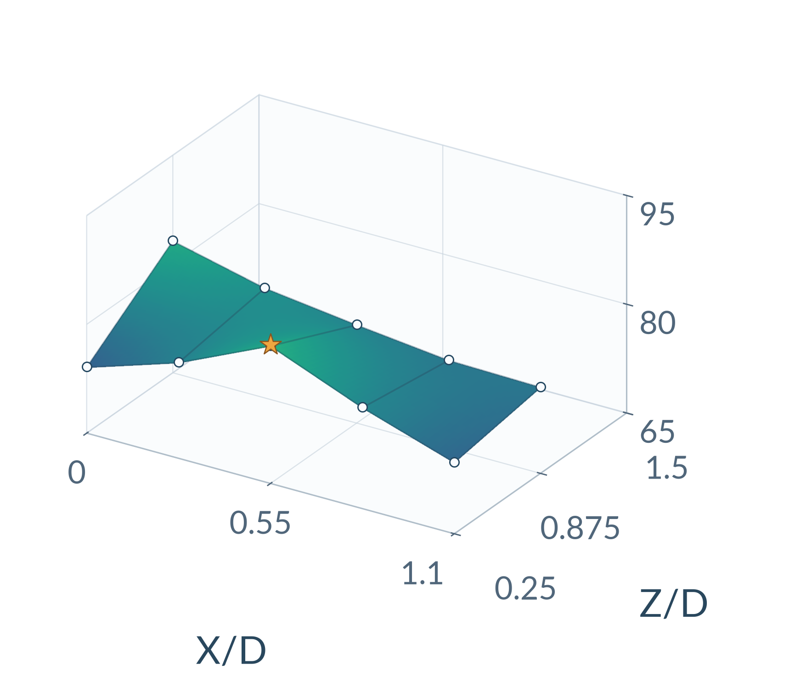
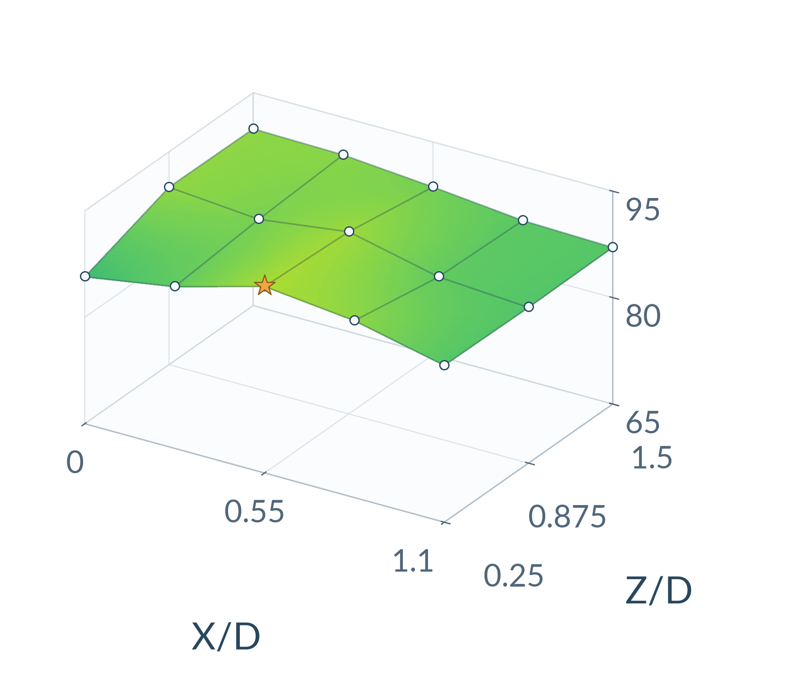
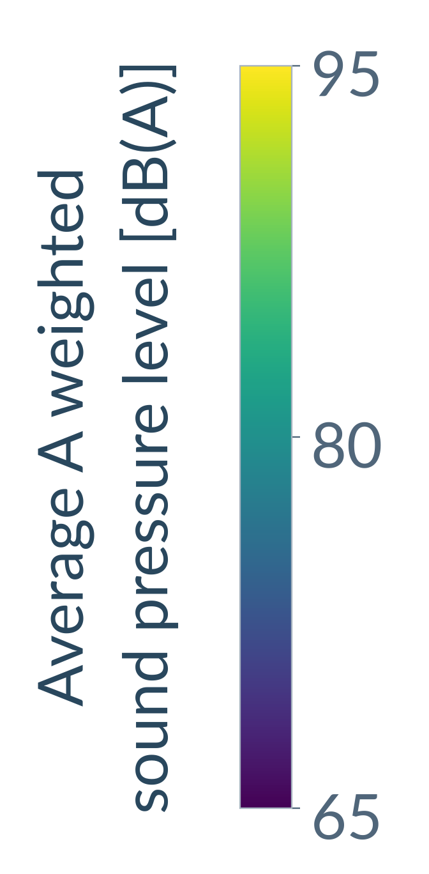
Initial measurements at three diameters
Nearly matched tip Mach number: 0.157
D = 6 cm
D = 13 cm
D = 40 cm
17,040 rpm per rotor
7,819 rpm per rotor
2,566 rpm per rotor
Common axes and color scale
PRELIMINARY
13 cm coverage ends at Z/D = 0.875
Arithmetic mean of nine reported dB(A) values, including two repeated entries. No extrapolation beyond measured positions.
10
Notes:
These are our first measurements, using six, thirteen and forty centimetre propellers. They come from an earlier dataset, separate from the APC sweep I just described. I chose one RPM condition for each diameter so the tip Mach numbers are nearly the same. All three plots use the same axes and color scale. The thirteen centimetre set does not cover the largest axial gap. At this stage, we're looking for repeatable patterns across size.

Slide 11
Similar spacing trends across three scales
A shared sampled peak
All three diameters peak at
X/D = 0.55 and Z/D = 0.25.
Their overall levels differ.
A similar spatial response
Rank correlations: 0.90 to 0.98
Across ten shared positions
at two axial spacings
Slice at Z/D = 0.25. Tip Mach ≈ 0.157.
PRELIMINARY
Mean microphone level in dB(A). Correlations use ten shared positions at Z/D = 0.25 and 0.875.
11
Notes:
This slice makes the shared pattern easier to see. All three diameters reach their sampled peak at the same relative spacing, even though their overall noise levels differ. We also compared ten positions that all three sizes have in common. The rankings are strongly related across those points. That is encouraging for the mapping idea, but a similar pattern is only the starting point. We still need to show that the relation can predict a diameter it has never seen.

Slide 12
Next steps for quieter UAM design and flight planing for air transportation
01
Continue simulation
Run propeller performance and noise cases
on our computing cluster.
02
Complete the test stand
Finish fabrication and collect measurements
across sizes, spacing and rotor speeds.
Quieter travel and delivery
03
Develop Scaling Laws
Help engineers choose efficient,
quieter layouts for passenger
travel and delivery.
Use machine learning to help connect scales,
then test predictions on an unseen diameter.
Better noise predictions can support aircraft design and urban transport planning.
NASA, Advanced Air Mobility; aircraft: Airbus, CityAirbus NextGen.
12
Notes:
Next, we'll continue running propeller performance and noise simulations on our computing cluster. We'll also finish manufacturing the test stand and use it to collect a broad dataset across sizes, spacing and rotor speeds. Then we'll use machine learning to help establish the transformation between scales, and test it on a diameter the model hasn't seen. Ultimately, I want to help engineers choose efficient, quieter layouts for passenger travel and delivery. Better predictions could also inform how these services fit into cities.

